Slide 1

Food Demand Forecasting For Restaurants

Slide 2
Objective:
The objective of this project is to forecast the demand for food in a delivery system.
The goal is to build a model that accurately predicts the number of orders for different meals in various fulfillment centers.
By understanding the demand patterns, the delivery system can optimize its operations and ensure efficient inventory management.

Slide 3
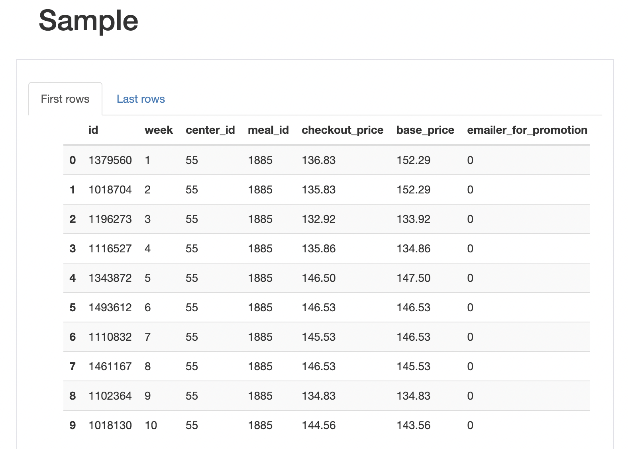
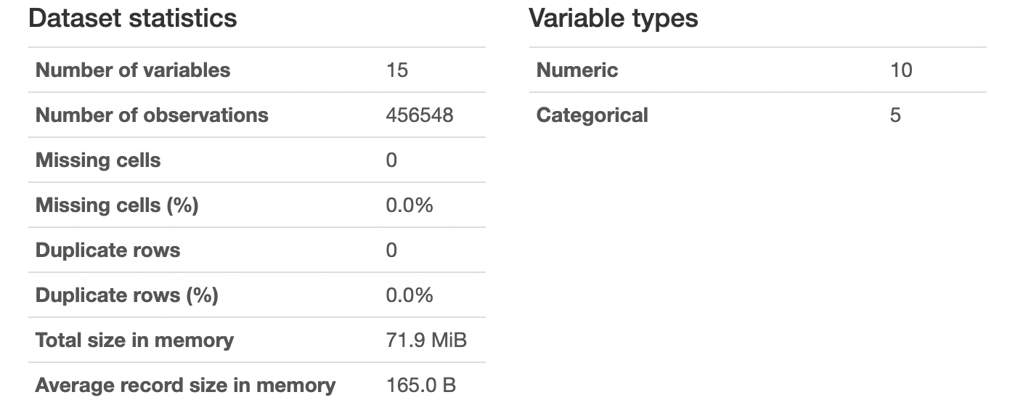
Data Set

Slide 4
Steps Performed
Data Import
Data Loading
Data Merging
Data Profiling
Data Preprocessing
Variable Identification
Exploratory Data Analysis (EDA)
Outlier Analysis
Correlation Analysis
Label Encoding
Train and Test Data Split
Model Training and Evaluation
Best Model Selection
Prediction Visualization

Slide 5
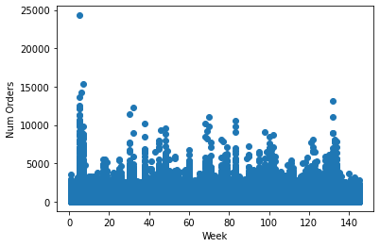
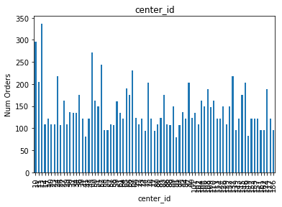
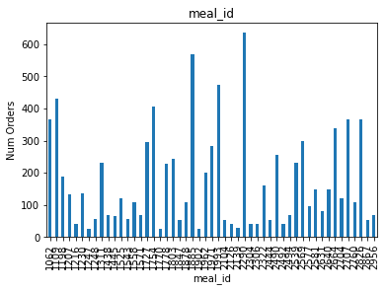
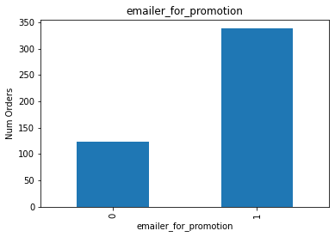
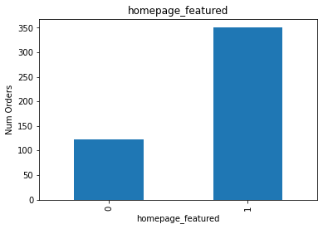
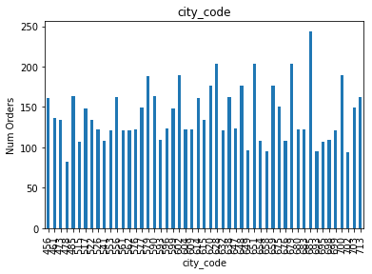
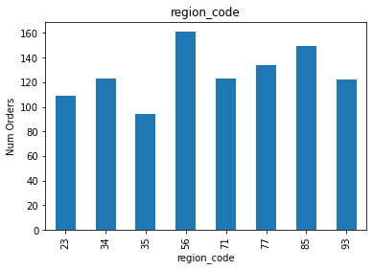
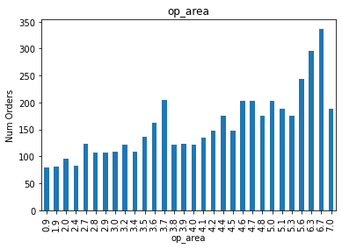
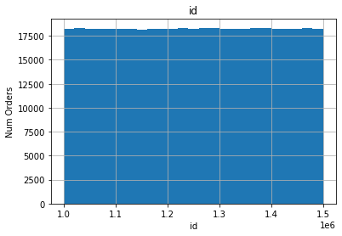
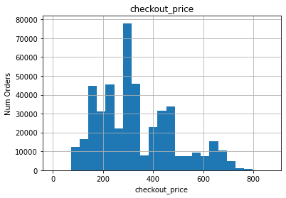
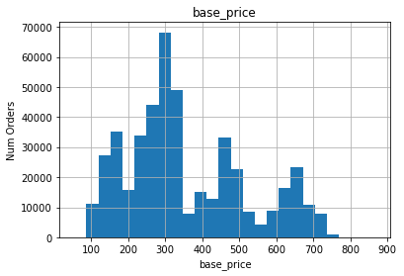
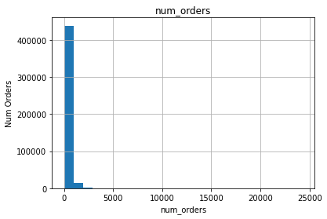
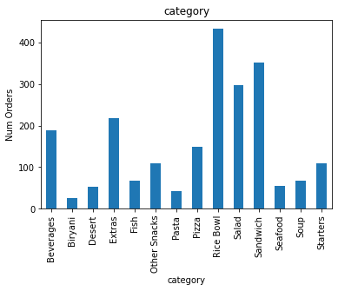
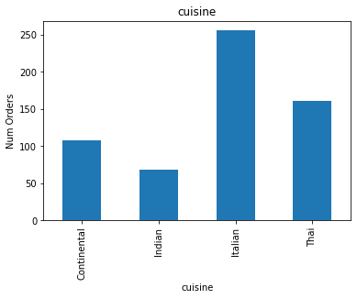
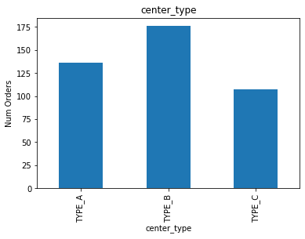
Exploratory Data Analysis (EDA)

Slide 6
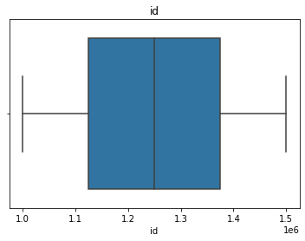
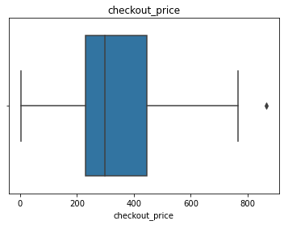
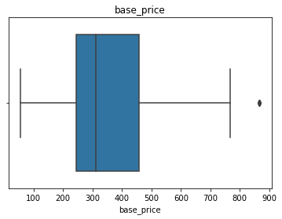
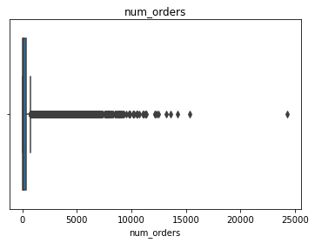
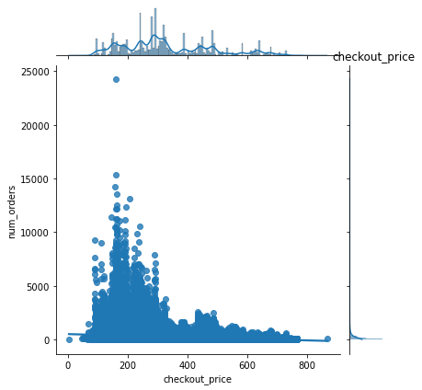
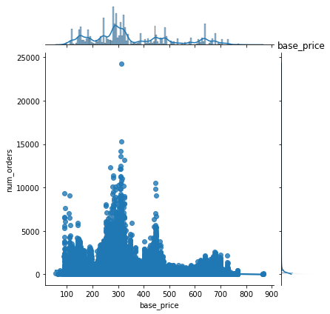
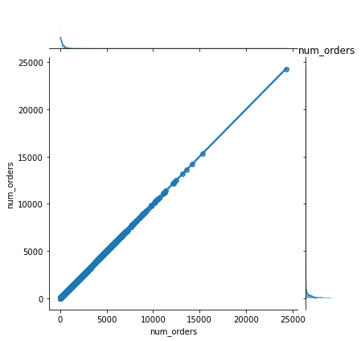
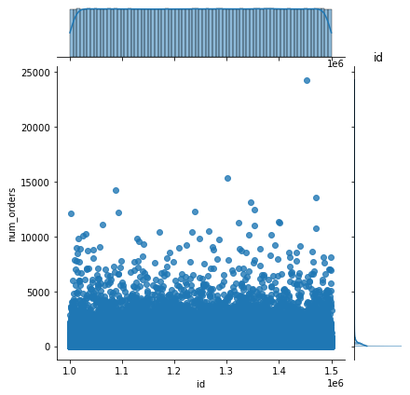
Outlier Analysis

Slide 7
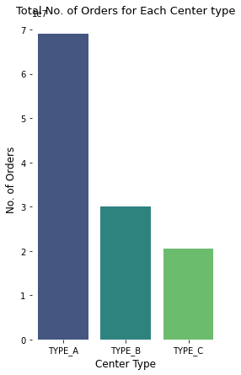
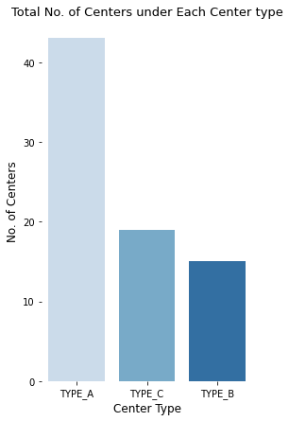
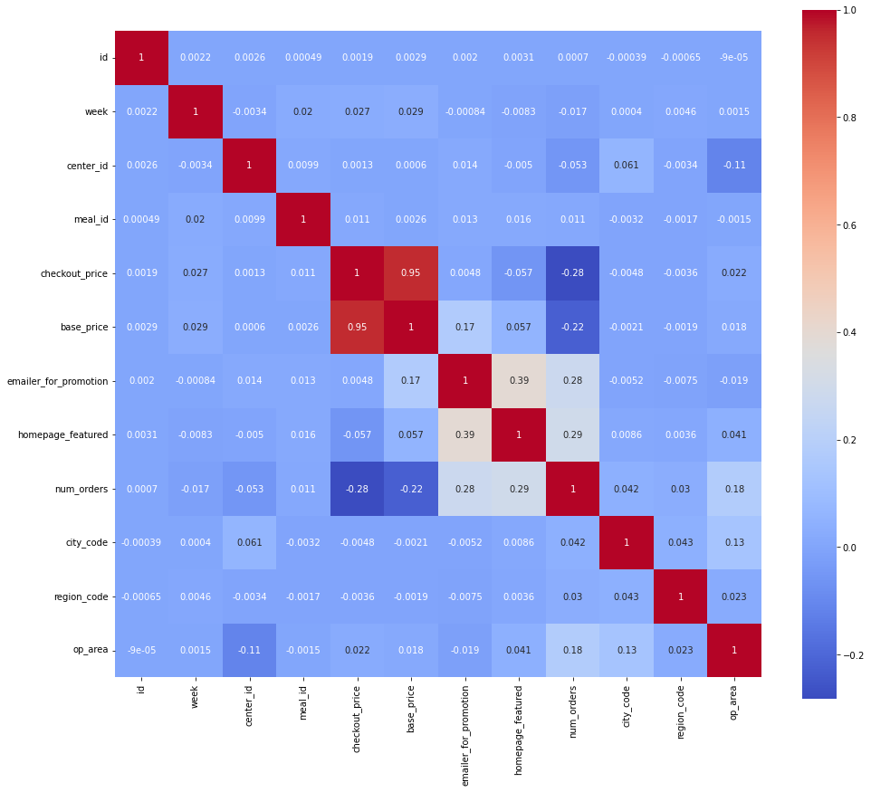
Visualizations:
Correlation heat map

Slide 8
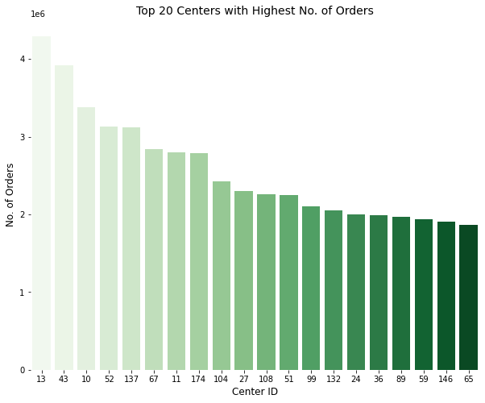
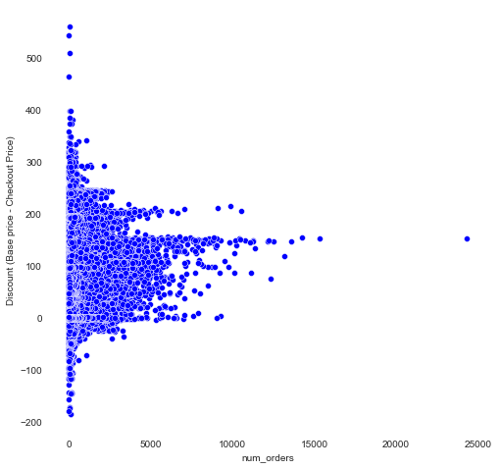
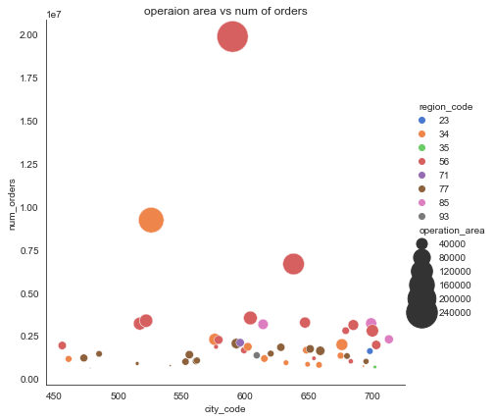
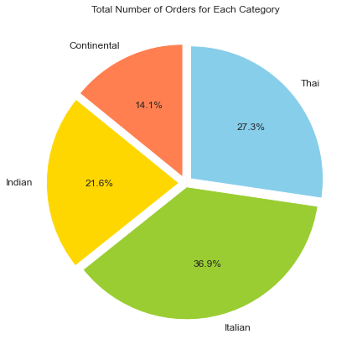
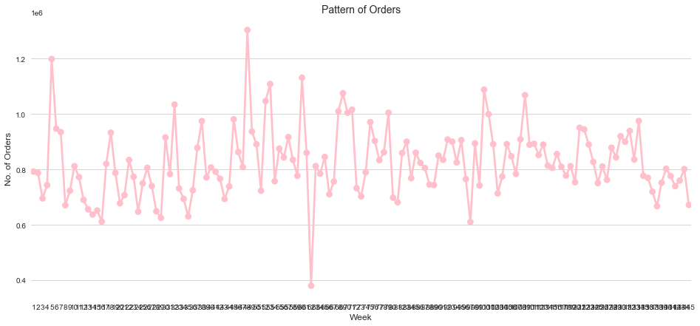

Slide 9
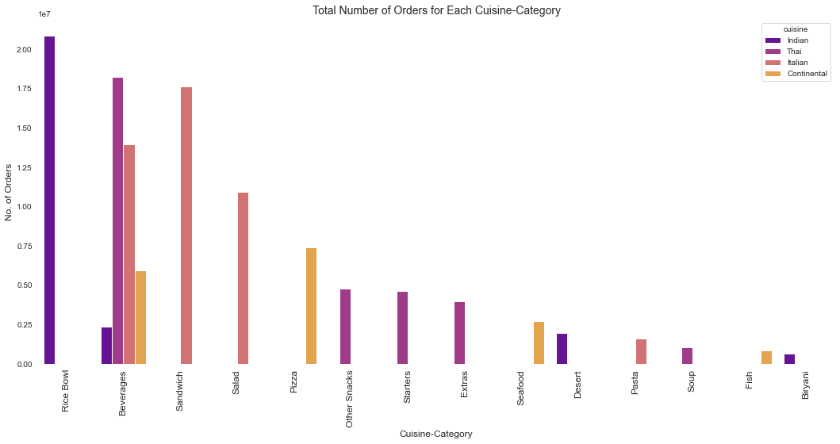
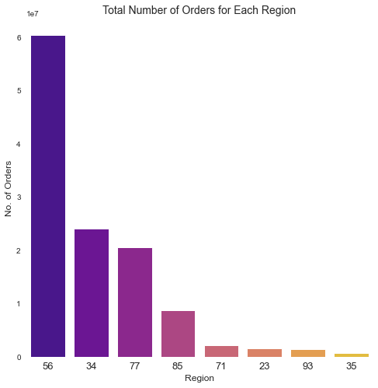
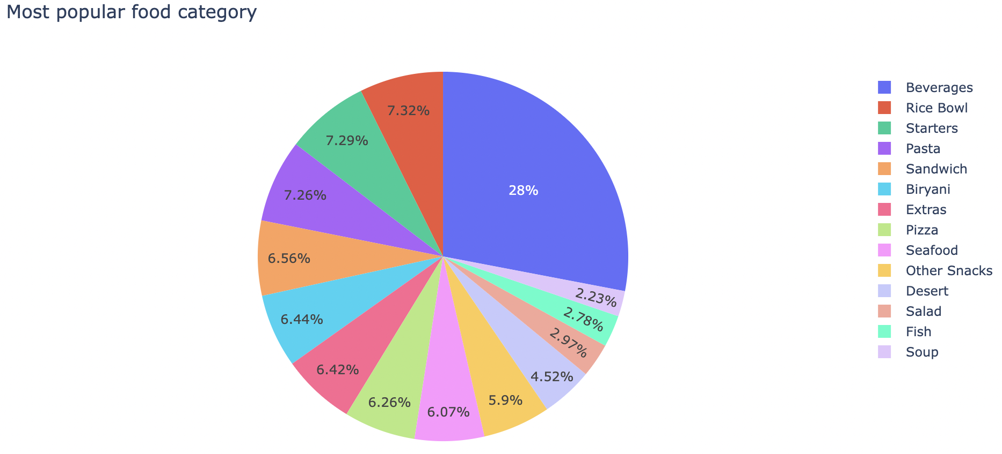
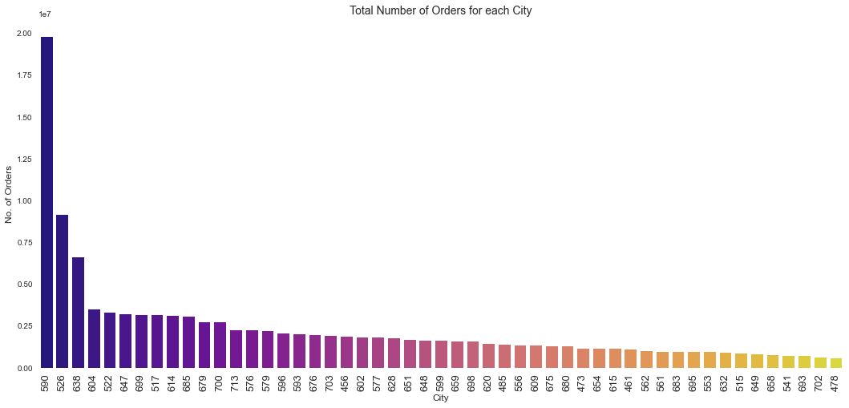
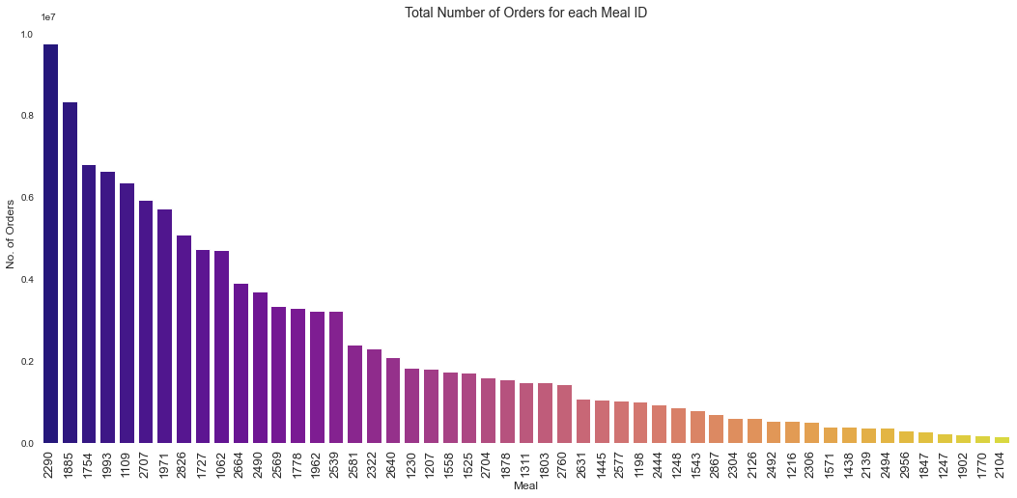

Slide 10
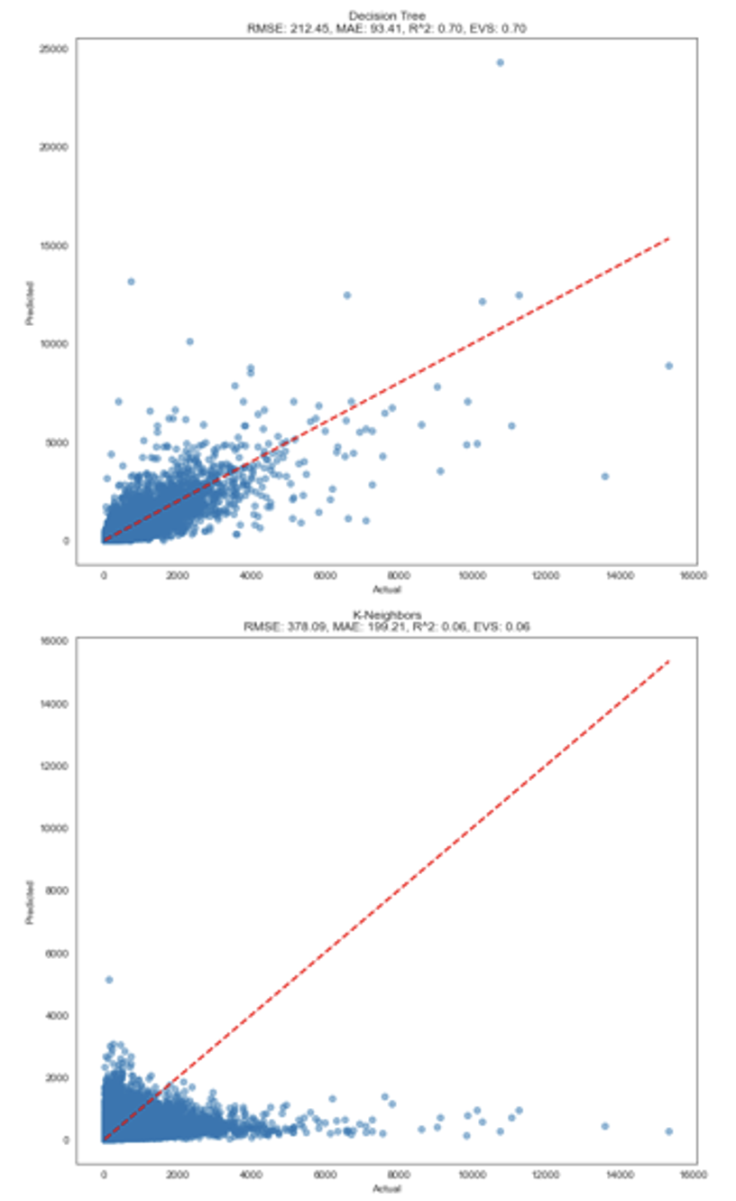
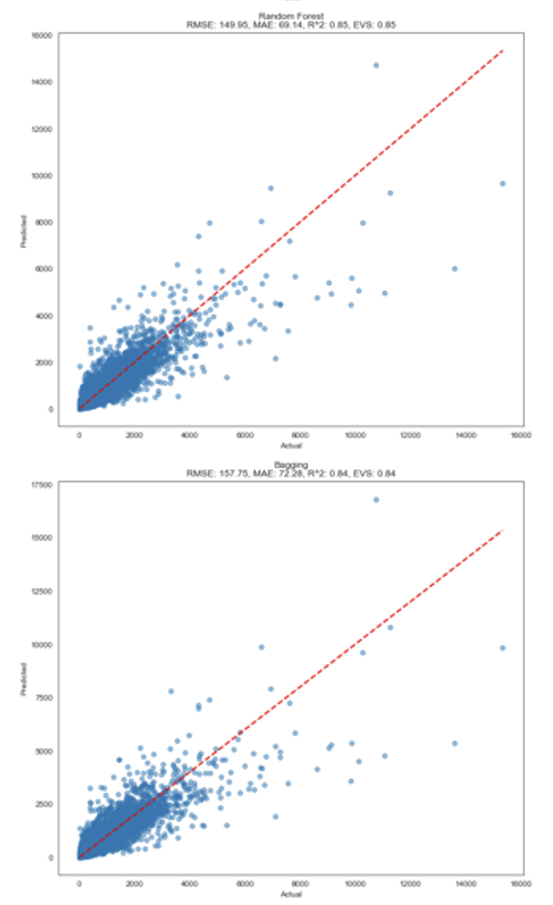
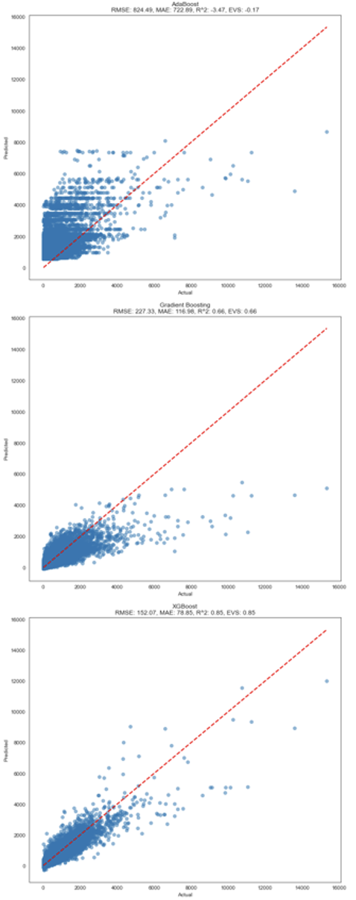
Results: Predictions Vs Actual results

Slide 11
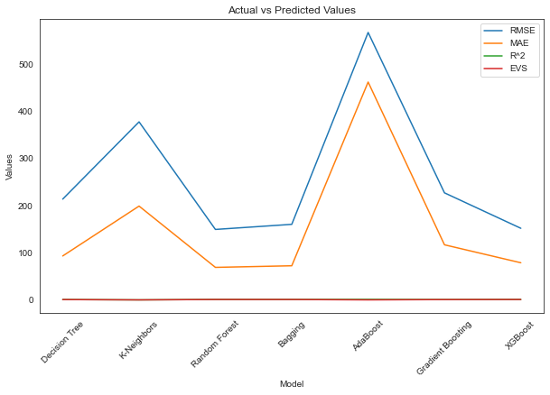
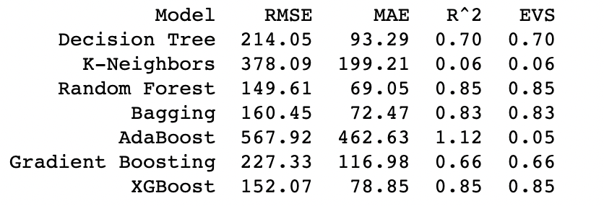
Best Model: Random Forest Regressor with RMSE: 149.34

Slide 12
Summary:
The dataset was examined for duplicate columns, duplicate rows, and missing values. The numerical, temporal, discrete, continuous, and categorical features were identified.
Various visualizations were created to understand the patterns and relationships in the data. These visualizations included scatter plots, bar plots, histograms, box plots, joint plots, and correlation heatmaps. Key insights were gained from the analysis of different features such as center type, region, cuisine, category, meal ID, city, and week.
Several regression models were trained and evaluated using the processed data. The models included Decision Tree, K-Neighbors, Random Forest, Bagging, AdaBoost, Gradient Boosting, and XGBoost regressors. The performance of each model was assessed using metrics such as RMSE, MAE, R^2, and explained variance score.
The model with the lowest RMSE was selected as the best model for forecasting food demand. This model can be further utilized for predicting the number of orders based on the given features.
Overall, the project aimed to analyze the food demand dataset and develop a predictive model to forecast the number of orders. The analysis provided valuable insights into the factors affecting food demand, and the trained model can be used to make accurate predictions in real-world scenarios. The results can help businesses optimize their operations and ensure efficient inventory management.

Slide 13
Enhancements :
In this final project, several enhancements were made compared to the midterm project. The code now incorporates data profiling techniques to identify duplicate columns, duplicate rows, and null values within the dataset. It also performs variable identification by distinguishing between numerical, temporal, discrete, continuous, and categorical features.
To gain insights into the data, Exploratory Data Analysis (EDA) techniques such as scatter plots, bar plots, histograms, and heatmaps are employed to visualize relationships and patterns. Additionally, outlier analysis is conducted using box plots and joint plots to identify any anomalies present in the data.
To facilitate further analysis, categorical variables are label encoded. The data is then split into training and validation sets, allowing for the training and evaluation of multiple regression models. These models are assessed based on their root mean squared error (RMSE), with the objective of selecting the model with the lowest RMSE as the best fit for the data.
Moreover, in addition to the KNN and Random Forest models (which gave good accuracy) used in the midterm project, several new regression models have been included and tested with the data. This expanded range of models provides a more comprehensive evaluation and allows for a better understanding of the data.
Lastly, the code incorporates various visualizations to aid in the interpretation of the results, enhancing the overall analysis and presentation of the project.

Slide 14
References:
https://www.kaggle.com/code/tevintemu/food-demand-forecasting
https://www.kaggle.com/code/anasvp1599/food-demand-forecasting-rmsle-48-72
https://www.kaggle.com/code/darshanbhavsar/food-demand-forecasting

